Slide 1
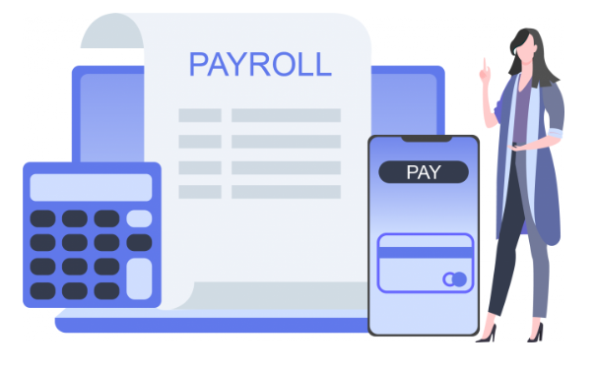
Employee Payroll Management
GROUP-3

Slide 2

TEAM MEMBERS
Employee_id Name
2563611 Soumya Ranjan Rout(Team Lead)
2563169 Dhineshkumar P A(Backend Lead)
2564041 Namrata K Kudachi
2563233 Rahul Chandra Mandal
2563463 Selvatharani A
2564001 Sompalli Bhavya
2563474 Aman Anand Srivastav
2563499 Karamsetty J Ch P Venkata Sai Maneesh
2564045 Rakshith Shetty
2563655 Tanuj Pandey

Slide 3

C
O
N
T
E
N
T
S
Introduction
Objectives
Microservices
Tools & Languages Used
Spring Cloud
App Flow
E-R Diagram
Features of Employee Payroll Management System
Advantages
Conclusion

Slide 4
Introduction
Employee payroll management is an Internet-based Java application.
It automates the working of a company or work center that manage and maintain records of the employees in the different department.
The proposed project “Employee Payroll Management ” has been developed to overcome the problems faced in the practicing of manual system.
This web application is reduced as much as possible to avoid errors while entering data And also provides error message while entering invalid data.

Slide 5
Objectives
The Employee Payroll Management is a set of processes that helps you streamline Salaries, Taxes and other necessary aspects of the net pay of all the employees in your Organization.
The Primary objective of the design is to deliver the requirement as delivered by the feasibility report.
There are some objective we kept in mind:
Practically : The system is quite stable and can be operated by the Employees with average intelligence.
Efficiency : We tried to involve accuracy, timeliness and comprehensiveness of system output.

Slide 6
MicroServices Modules:
Attendance Microservice
Employee Microservice
Leave Microservice
Salary Microservice
ToDo Microservice
User Microservice

Slide 7
What are Microservices?
Microservices is also know as the microservice architecture
It is an architectural style that structures an application as a collection of services that are
Highly maintainable and testable
Loosely coupled
Independently deployable services
Organized around business capabilities
Owned by small team

Slide 8
Characteristics of Microservice Architecture
Componentization via services
Organized round Business Capabilities
Products not Project(“you build, you run it”)
Smart endpoints and dumb pipes
Decentralized Data Management
Infrastructure Automation

Slide 9



Tools and Technologies:
Server-side: Spring Boot, Spring Cloud, Spring Data JPA
Database: MySQL, H2
Server: Embedded Tomcat
DevOps: Docker, Git Hub
Spring Cloud: Spring Cloud Config, Spring Cloud Netflix Eureka, Feign, Resilience4j, Retry, Sleuth and Zipkin

Slide 10
Server-Side:
Spring Boot:
Spring Boot is an open-source Tools. It is a project that is built on the top of the Spring Framework.
It provides an easier and faster way to set up, configure, and run both simple and web-based applications.
Spring Data JPA:
It aims to significantly improve the implementation of data access layers by reducing the effort to the amount that's actually needed
Spring Data JPA provides repository support for the Jakarta Persistence API (JPA). It eases development of applications that need to access JPA data sources.

Slide 11
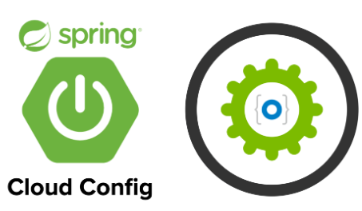
Spring Cloud:
Spring cloud provides tools for developers to quickly build some of the common patterns in distributed systems (e.g., configuration management, service discovery, circuit breakers, intelligent routing, micro-proxy, control bus, one-time tokens)
Spring cloud focuses on providing good out of box experience for typical use cases and extensibility mechanism to cover others
Distributed/Versioned configuration
Service registration and discovery
Routing
Service to service calls
Circuit Breakers

Slide 12
Spring Cloud Config Server
The Spring Cloud Config server is an externalized configuration server in which application and services can deposit access and manage all runtime configuration properties
The Spring config server also supports version control of the configuration properties.
The Spring Config server storess properties in version-controlled repository such as Git or SVN. The Git repository can be local or remote. A highly available remote Git server is preferred for large scale distributed microservice deployments.

Slide 13
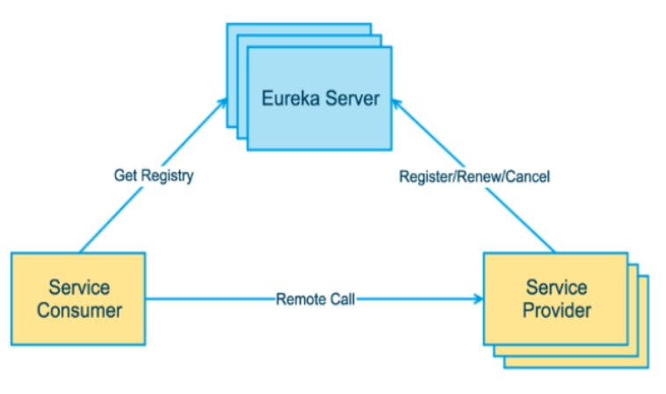
Spring Cloud Netflix Eureka
Spring Cloud Netflix provides Netflix OSS integrations for Spring Boot apps through auto-configuration and binding to the Spring Environment and other Spring programming model idioms.
With a few simple annotations, you can quickly enable and configure the common patterns inside your application and build large distributed systems with battle-tested Netflix components.
The patterns provided include Service Discovery (Eureka). Eureka is the Netflix Service Discovery Server and Client.

Slide 14
Spring Cloud Feign
Feign is a Spring Cloud Netflix library for providing a higher level of abstraction over REST-based service calls.
Spring Cloud Feign offers a declarative approach for making RESTful service-to service call in a synchronous way.
When using Feign, we write declarative REST services at the client, and use those interfaces to program the client.
<dependency>
<groupId>org.springframework.cloud</groupId>
<artifactId>spring-cloud-starter-openfeign</artifactId>
</dependency>

Slide 15
Resilience4j - Circuit Breakers
Resilience4j is a lightweight fault tolerance library designed for
functional programming that provides a variety of fault tolerance and
stability patterns to web application.
Resilience4j provides higher-order functions (decorators) to enhance
any functional interface, lambda expression or method reference
with a Circuit Breaker, Retry or Bulkhead.
What is Circuit Breaker ?
The circuit breaker is essentially a pattern that helps to prevent cascading failures in a system.
The circuit breaker pattern allows you to build a fault-tolerant and resilient system that can survive gracefully when key services are either unavailable or have high latency.

Slide 16
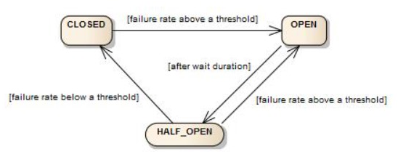
Circuit Breakers States
CLOSED: In this state, the circuit is operational, and requests are allowed to pass through. The circuit counts failures, and if the failure rate exceeds a defined threshold, it transitions to the OPEN State.
In the OPEN state, the circuit is tripped, and requests are not allowed to pass through. This state remains for a specified time (reset timeout) to allow the external service to potentially recover.
HALF_OPEN: After the reset timeout, the circuit transitions to the HALF_OPEN state, allowing a limited number of test requests to pass through. If those test requests are successful, the circuit transitions back to CLOSED; otherwise, it returns to OPEN.

Slide 17
Retry:
The operation is retried if a Runtime Exception is thrown during the remote call. We can configure the number of attempts, how long to wait between attempts
etc.: RetryConfig config = RetryConfig. custom().
We can enable retry in our spring boot application using @EnableRetry annotation at configuration class or in main class.
Second annotation that is @Retryable that we can apply at method level on which method we want to perform retry operation in case of failure.

Slide 18
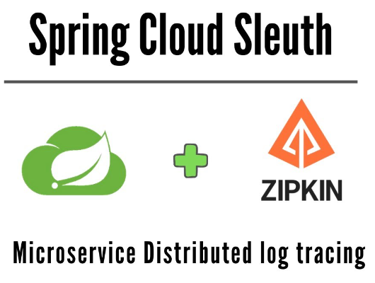
Sleuth
Sleuth is another tool from the Spring cloud family.
It is used to generate the trace id, span id and add this information to the service calls in the headers, so that it can be used by tools like zipkin and ELK etc. to store index and process log files.

Slide 19
Zipkin
Zipkin is a very effective tool for distributed tracing in the microservices ecosystem.
Distributed tracing, in general, is the latency measurement of each component in a distributed transaction where multiple microservices are invoked to serve a single business use case.
Distributed tracing is useful debugging when lots of underlying systems are involved, and the application becomes slow in any situation.
It manages both the collection and lookup of this data. To use Zipkin, applications are instructed to report timing data to it.

Slide 20
POSTMAN:
The Postman testing tool is a complete API development platform with various built-in tools that support every stage of the API lifecycle. Postman is an API client that makes it easy for developers to create, share, test and document API.
MySQL:
MySQL is an open source relational database management system.(RDMS) developed by Oracle that is based on structured query language (SQL).
As with other relational databases, MySQL stores data in tables made up of rows and columns. Users can define, manipulate, control, and query data using Structured Query Language, more commonly known as SQL.
Git Hub:
Docker provides a set of official GitHub Actions for you to use in your workflows. These official actions are reusable, easy-to-use components for building, annotating, and pushing images

Slide 21
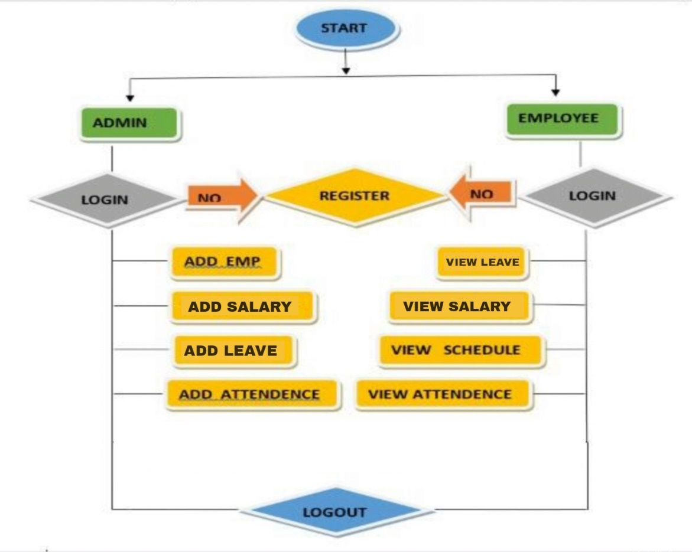
APP-FLOW

Slide 22
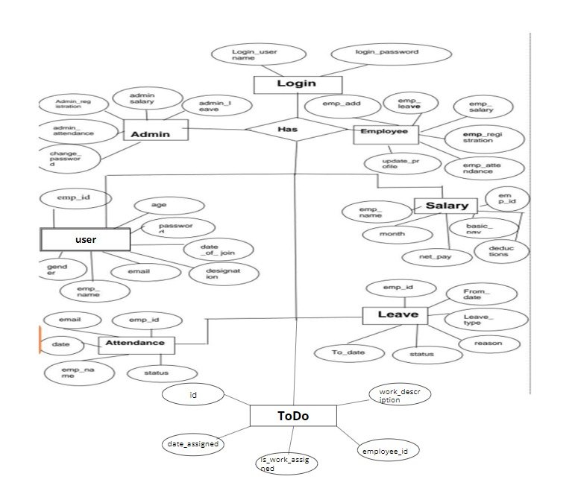
E-R Diagram:

Slide 23
Features of Employee Payroll Management
Automates and Streamlines the process of paying your employees for their work.
It is completely secure.
This system is easily compatible with most of the web browsers.
Admin can view all the records whenever necessary with ease.

Slide 24

Advantages
Helps the employee easy way to access their data.
The information related to employee can be added , edited, removed easily.
Store the end-to-end data of the employees
Increases Employee Satisfaction And Retention
Reduces Errors And Saves Time
Enhances Data Security

Slide 25
Conclusion
The Employee Payroll Management is the software developed for a company to achieve maximum efficiency and reduce the time taken to handle the Payroll Activity.
The project aims to make things easy and accurate and it is designed to replace an existing manual record system there by reducing time taken calculations and Storing Data.
A payroll management system can provide benefits for organizations of all sizes and industries.
By reducing errors, improving compliance with labor laws and regulations, enhancing data security, increasing employee satisfaction and retention, and providing real-time reporting and analytics, a payroll management system can help organizations save time, reduce costs, and improve overall financial health.

Slide 26


